Slide 1
Network problems
By: Sanad Kakish

Slide 2
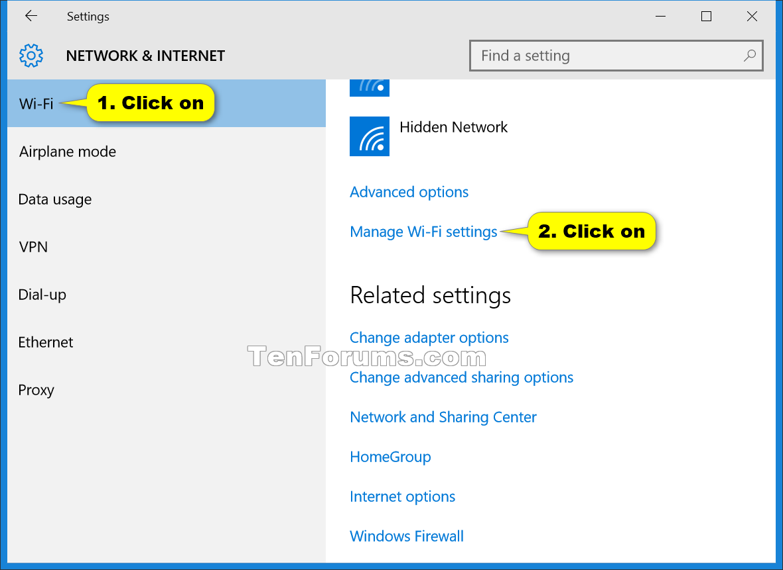
If u ever face any internet problems here is what to do:
Check if your computer is connected
to your internet from the setting of the
computer.
Try to turn the router off then back on
Maybe your internet is weak I suggest you
To buy fiber.
This Photo by Unknown Author is licensed under CC BY-SA

Slide 3
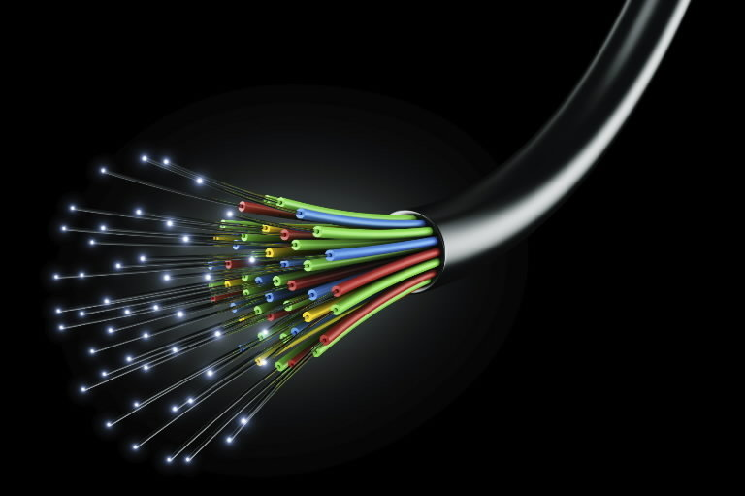
Ways to prevent internet problems:
You can prevent it by buying a faster internet like fiber or buy cables that can make the internet connection faster.
This Photo by Unknown Author is licensed under CC BY-SA

