Slide 1
Cybercrime
Made by Tina Bqaeen

Slide 2
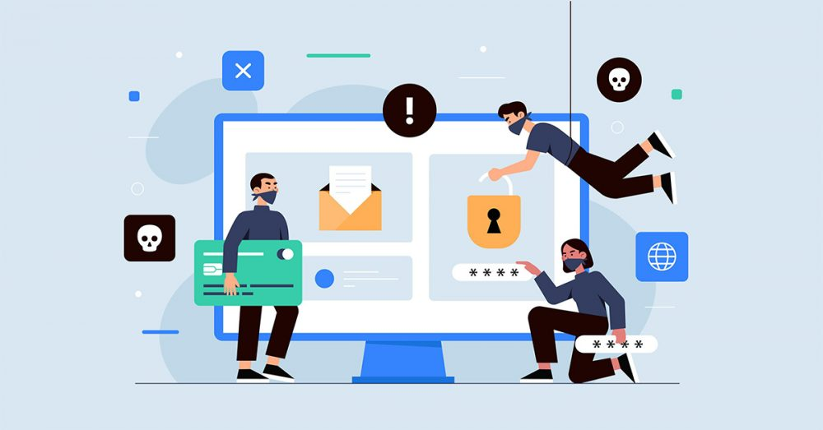
What is a cybercrime
Cybercrime is any criminal activity that involves a computer, networked device or a network.

Slide 3
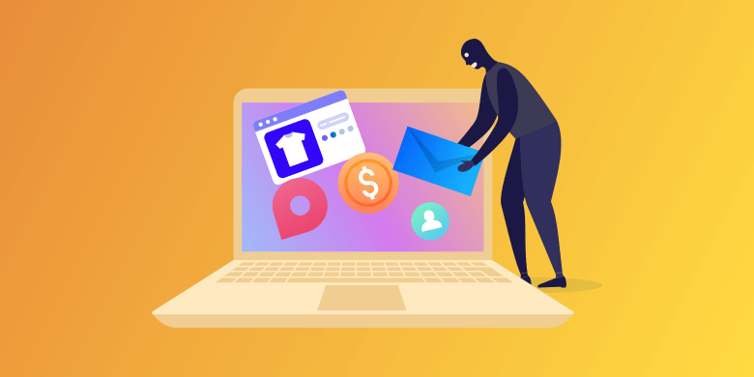
Who is a cyber criminal
cybercriminals are individuals or teams of people who use technology to commit malicious activities on digital systems or networks with the intention of stealing sensitive company information or personal data, and generating profit.

Slide 4
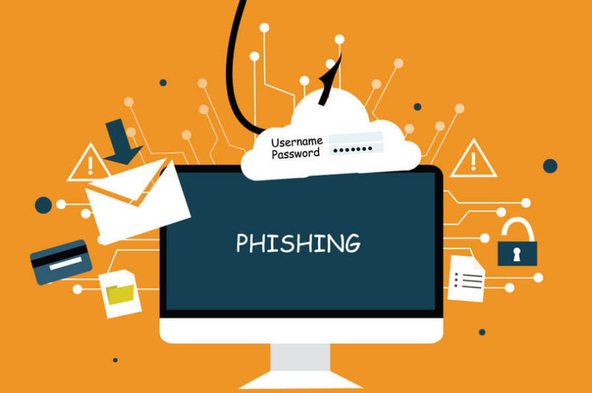
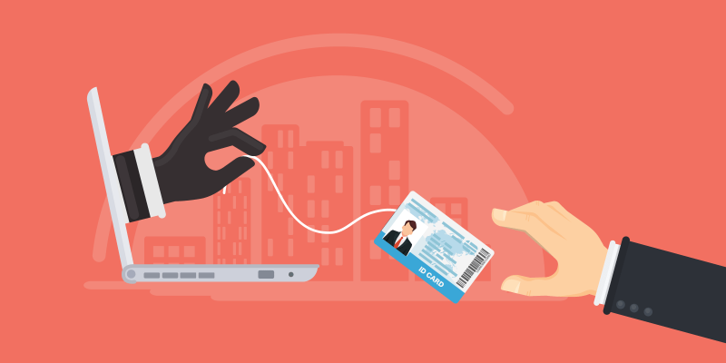
Types of cybercrime
Phishing scams.
Identity theft.
Hacking.

Slide 5
Phishing scams
A criminal creates a fake website that looks like the official website of a real bank or an internet shopping website. The criminal then writes a fake email that looks like it comes from the bank or shopping website.
The email tells the person receiving the email that there is a problem with their account and they must log in the solve the problem. There is a link to their fake website. When the person logs in, the fake website records their username and password. The criminal can then use the person’s login details to steal money.

Slide 6
Identity theft
A criminal steals personal information such as a person’s name and address. They also steal official information such as social security numbers or passport numbers. Criminal can use a stolen identity to pretend they are someone else. They can open a bank account or a credit card account in someone else's name. They then use these fake accounts to buy goods or to steal money from banks.

Slide 7
Hacking
A criminal breaks into a computer system, usually to steal files or personal information. Hackers usually try to break into computer systems that hold a lot of personal information. Bank systems are an example of systems that hackers attack.

Slide 8
How can you protect yourself from cybercriminals
Use strong passwords
Keep your software updated
Manage your social media settings
Strengthen your home network
Take measures to help protect yourself against identity theft

