Slide 1
To act responsibly and safely when solving computer problems
By yasmeen

Slide 2
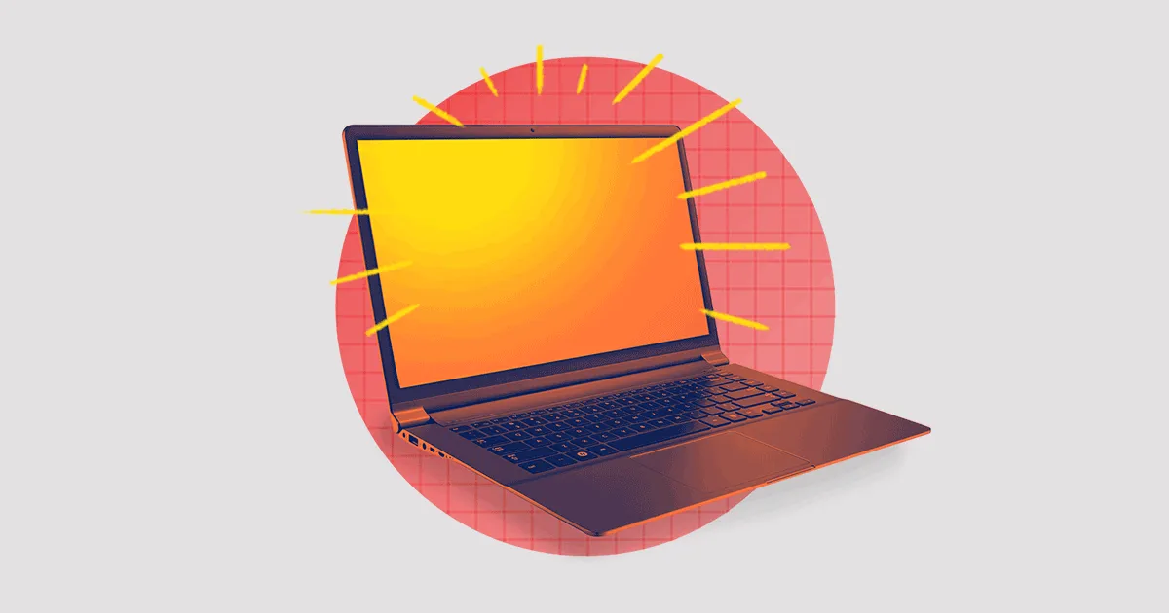
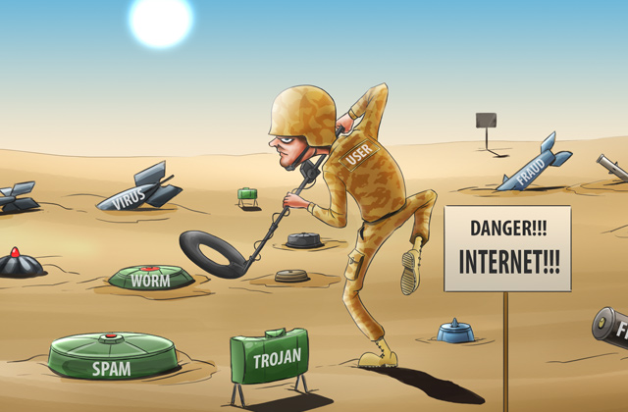
Why is it important to keep my computer safe
If you don’t protect you computer while your online its possible that personal details can be stolen or deleted without you knowledge

Slide 3
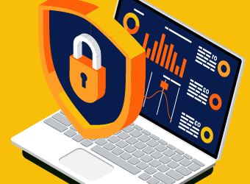
How can we keep my computer safe
1.Downlaod an antivirus
2.Use a unique password
4.Keep personal information safe and only to you
5.Be careful what you download
6.Take back-ups

Slide 4
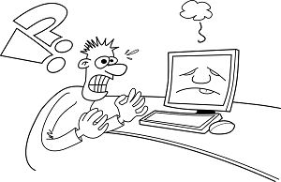
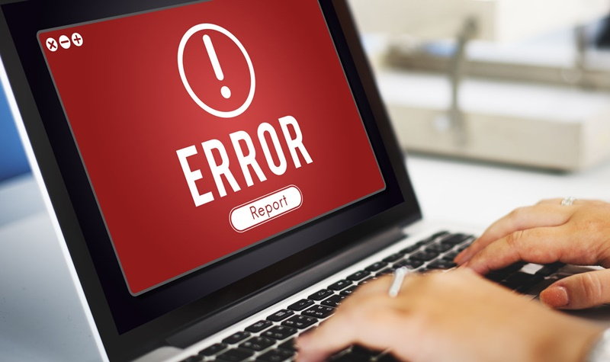
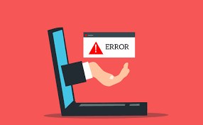
What is a computer problem
A computer problem is when you computer stops working properly such as the windows wont boot, the screen is frozen, low internet, overheating, not charging, strange noises, computer is slow, and so on.

Slide 5
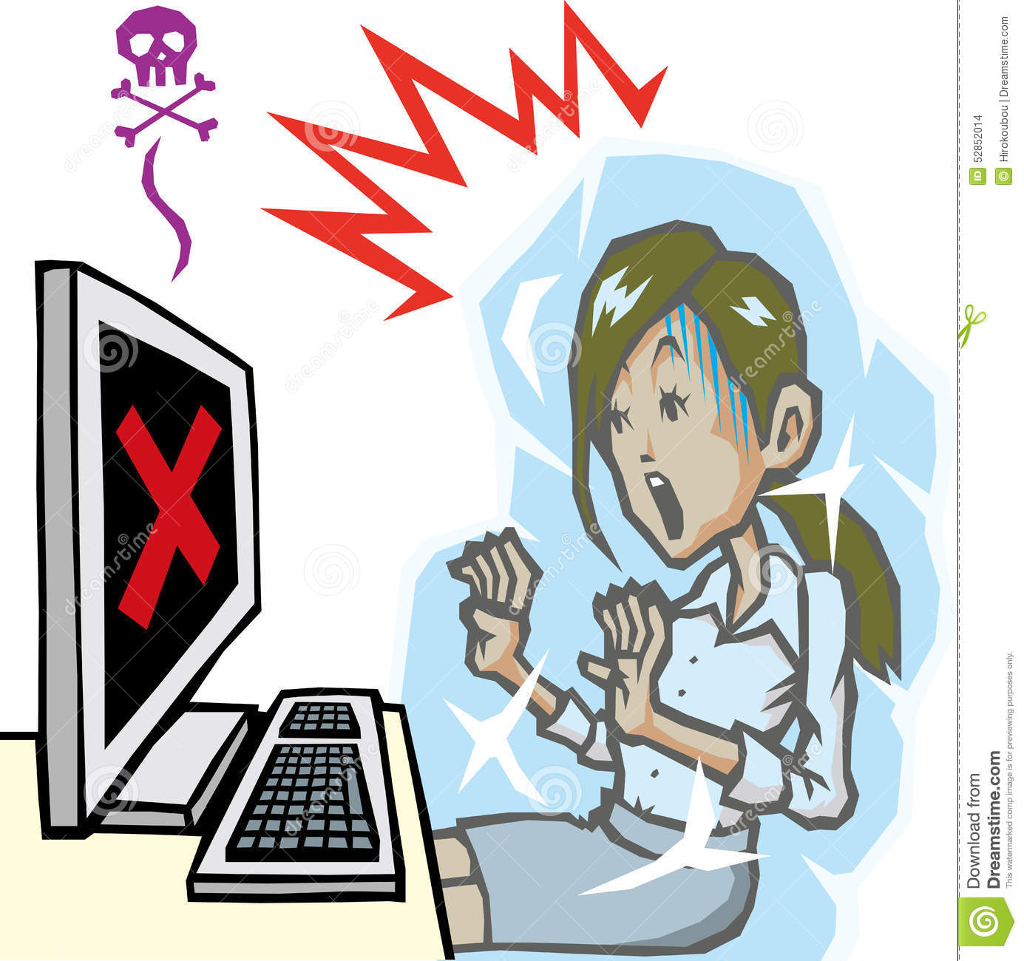
How can I keep my computer from having any problems
1.Run a through virus scan/use firewall
2.Update your device/software
3.Cut down the bloat
4.test your Wi-Fi connection
5.Reinstall the operation system
6.dont keep your computer in charge all the time

