Slide 1
PROBLEM in my laptop
Maria hadaddin
8A

Slide 2
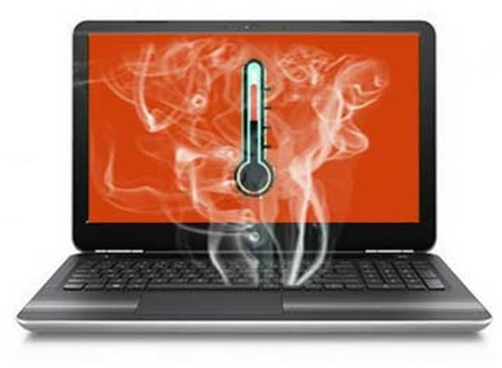
Overheating
Symptom: Computer crashes, freezes
Solution: Clean out air vents, put filtered material over the inhalation vent, or update BIOS

