Slide 1
Acting responsibly and safely when solving computer problems.
Zaid Haddad 8D

Slide 2
Introduction This pptx will talk about Acting responsibly and safely when solving computer problems.

Slide 3
Hackers
If you act responsible while solving these problems and put passwords and do updates it will progressively get harder for hackers to enter your account and get you personal information.

Slide 4
updates
If there is a problem with the servers and hackers are entering accounts there will be new software updates that make it harder and sometimes impossible for them to enter unless they find a way to crash the servers.

Slide 5
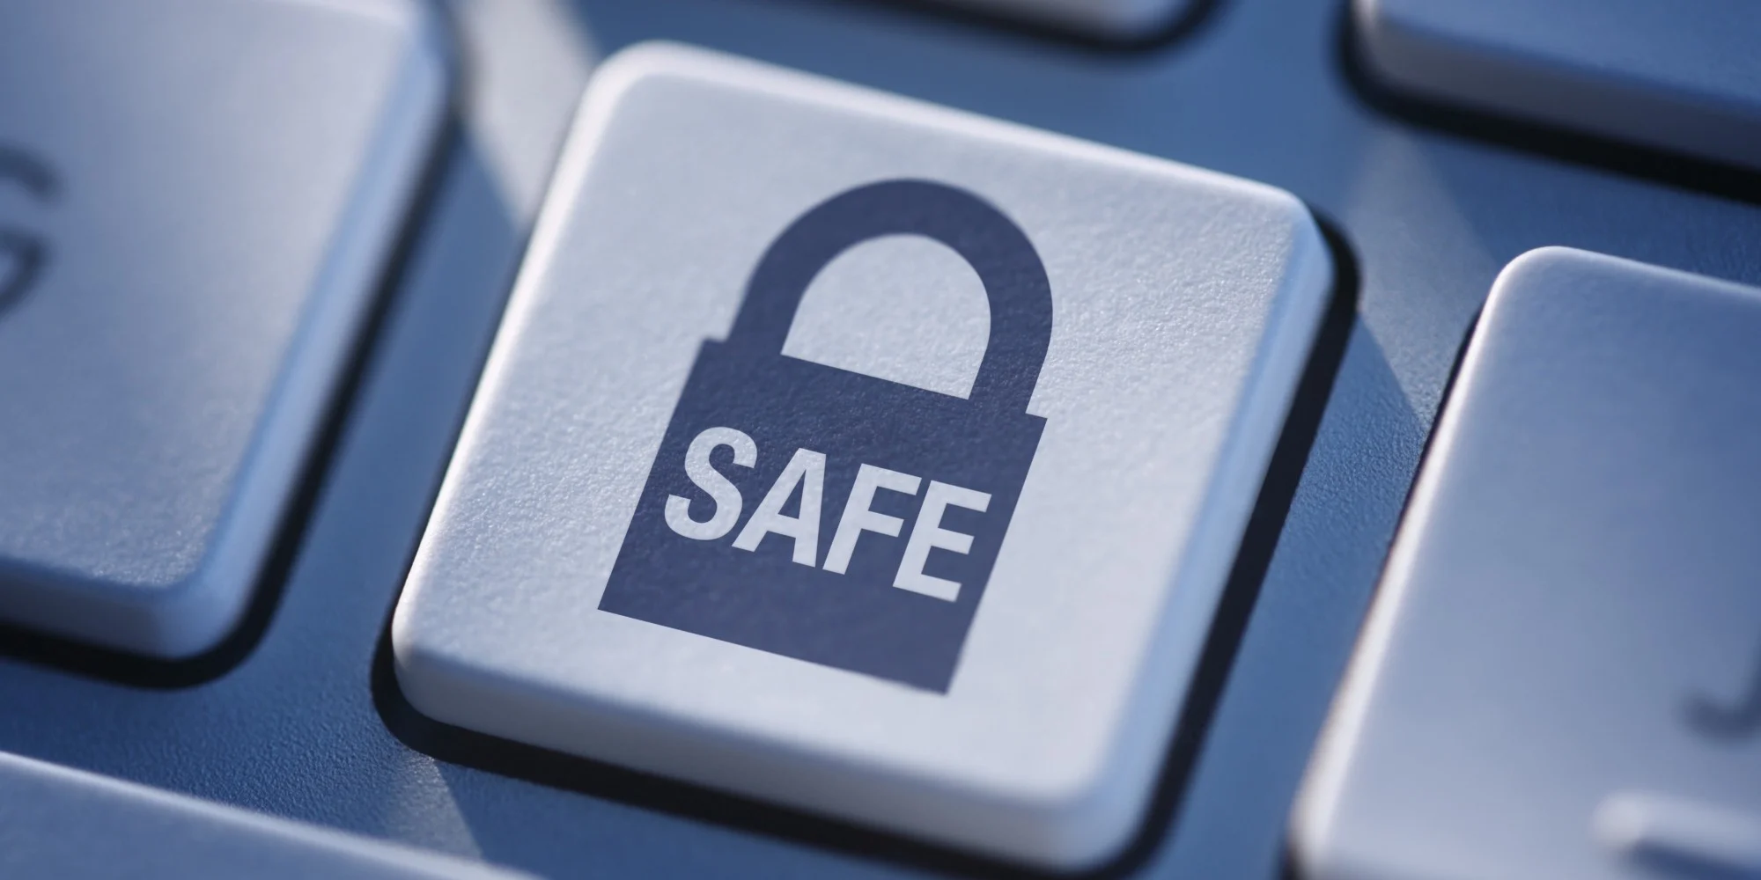
Conclusion
You should always be aware and solve your computer problems as fast as possible before any hackers enter your account.

