Slide 1
Cybercrime
By: Yara naffa
Grade:7 CP E

Slide 2
What is cyber crime?
Any illegal or unethical activity through internet use or using computer as a tool can be a cyber crime. Cyber crime is done by cyber criminals who try to exploit broken software.

Slide 3
Some types of cybercrime
Email and internet fraud.
Identity fraud (where personal information is stolen and used).
Theft of financial or card payment data.
Theft and sale of corporate data.
Cyberextortion (demanding money to prevent a threatened attack).
Ransomware attacks (a type of cyberextortion).

Slide 4
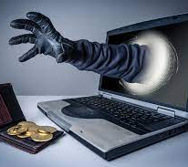
What are the causes of cybercrime?
Most often, cyber attacks happen because criminals want your: business' financial details. customers' financial details (e.g. credit card data) sensitive personal data.

Slide 5
How can we prevent cybercrime?
Check security settings to prevent cybercrime: A cyber firewall checks your network settings to see if anyone has logged into your computer.

