Slide 1
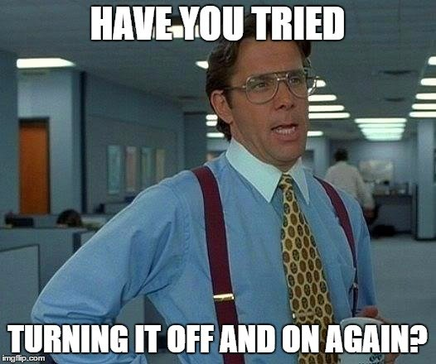
How can someone act responsibly while solving computer problems?
by: faris sawalha 8G

Slide 2
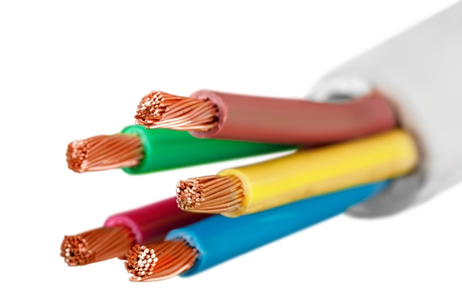
SWITCH THE POWER POINTS OFF AT THE WALL BEFORE CONNECTIONG OR DISCONECCTING A MAIN ELECTRICITY CABLE

Slide 3
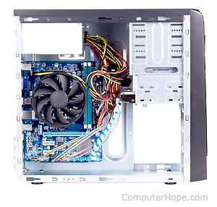
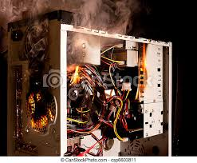
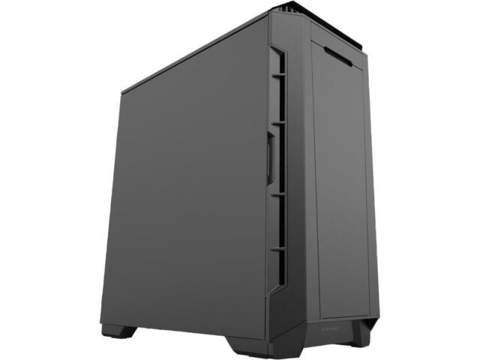
Do not open the case of your computer or any other device
Oh yes !! Please !!

Slide 4
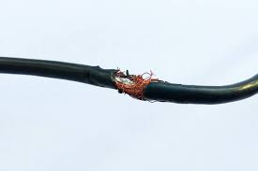
Never use force when connecting or disconnecting cables

Slide 5
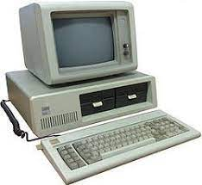
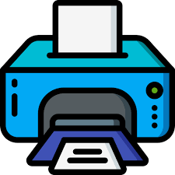
Make sure all cables are disconnected before moving any device

Slide 6
Never lift any heavy equipment on your own as you can hurt yourself!

Slide 7
Thank you for listening to my presentation about safety of solving network problems!

