Slide 1
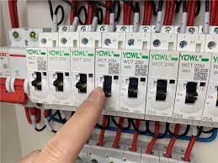
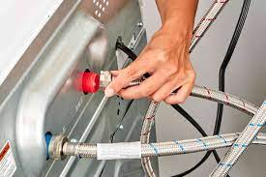
Responsibility and safety? Got it!
You should never lift heavy equipment on your own
If you’re confused never be afraid to ask for help
Make sure all of the cables are disconnected before moving a device!
Switch off power points before connecting or disconnecting electricity cables
☺Always remember to not use force when connecting cables ☺
☺Always remember to not use force when connecting cables ☺

