Slide 1
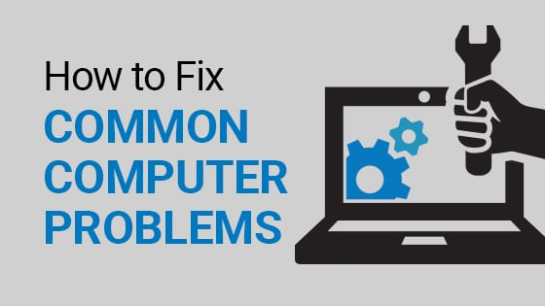
Made by :saif Fashho and sami abbasi

Slide 2

Our first computer problem is Loud Noises from Computers
Many people have an issue with this problem that there computer is making a loud noise
Many people think that having a loud noise from the computer is not a big problem however this loud sound leads to hardware failure.
Made by saif Fashho

Slide 3
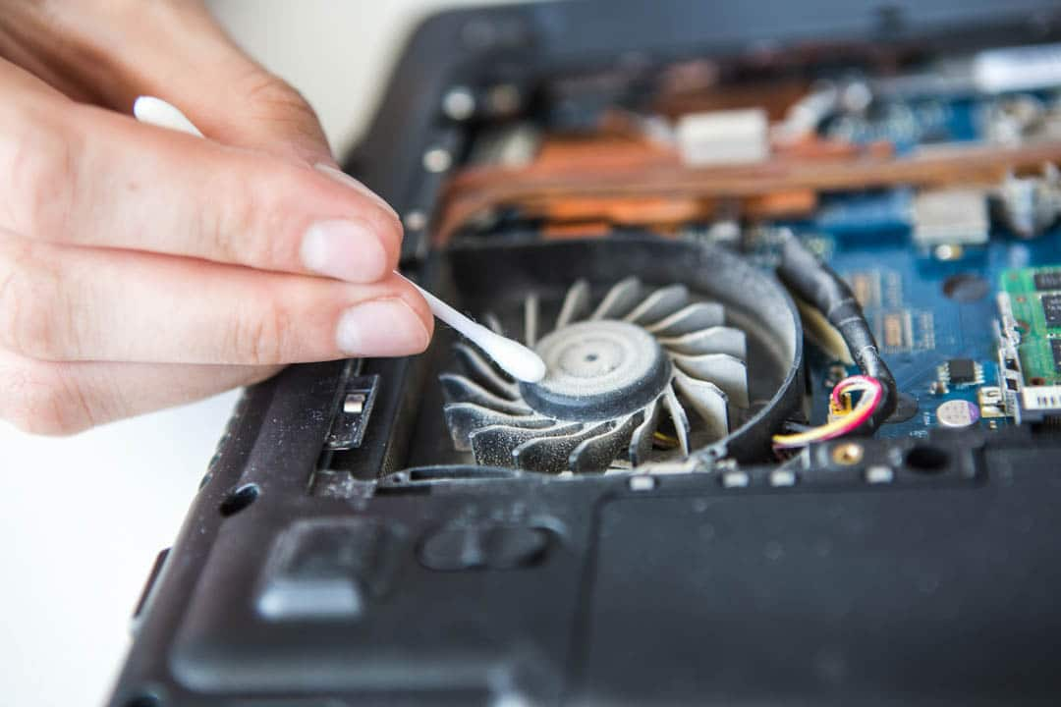
How to solve this loud noise in your computer?
You can fix a noisy computer fan with a few simple steps. Here are quick tips to keep your computer quiet:
Close background apps and processes
Close open tabs in your browser
Increase airflow around your computer’s vents
Clean out dust in ports and vents
Turn off your computer, wait a few minutes, and then turn it back on again
Go to a ict mechanic and tell him the problem
Made by saif Fashho

Slide 4
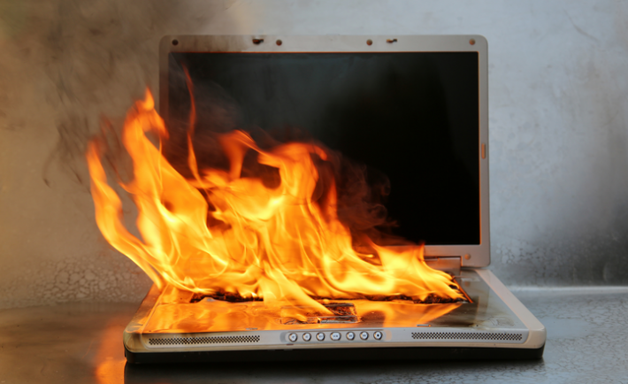
What do I do if my laptop overheats?
When your laptop overheats, prompt action is warranted. The simplest
solution is to just take a break from using it. Power it down and put it in
a cool, dry location until it&#39;s completely cool to the touch, then wait ten
more minutes. Keep the laptop positioned on a flat, hard surface while
You’re using it.
Made by sami abbasi

Slide 5

How can I cool my laptop?
Here are some simple ways to do that.
Avoid carpeted or padded surfaces.
Elevate your laptop at a comfortable angle.
Keep your laptop and workspace clean.
Understand your laptop’s typical performance and settings.
Made by sami abbasi

