Slide 1
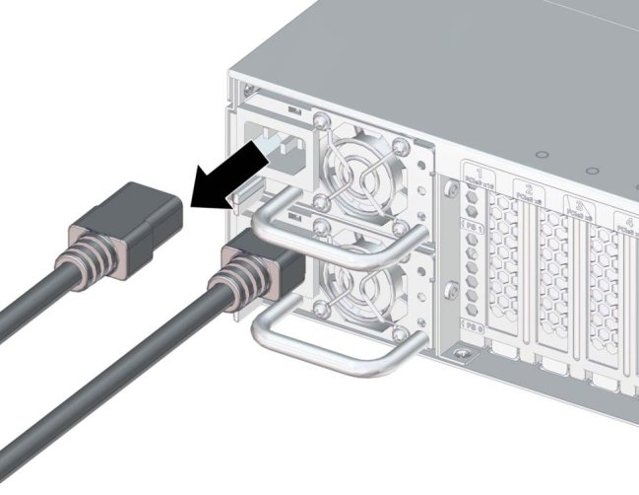
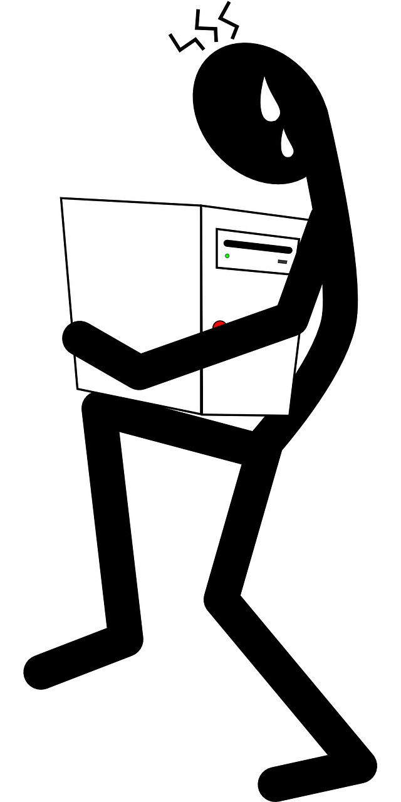
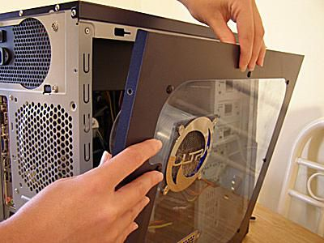
How to act responsibly and safely when solving computer problems
Don’t forget to switch off power points at the wall before connecting or disconnecting a mains electricity cable!
Don’t lift heavy equipment on your own!
Never use force to connect or disconnect a cable & make sure ALL cables are disconnected before you move any device!
Never ever open the case of your computer!
If in doubt….
And ask for help!
Prepared by:
Haya Bataineh 8D

