Slide 1
overheating
By Adeeb ALAMAT 8F

Slide 2
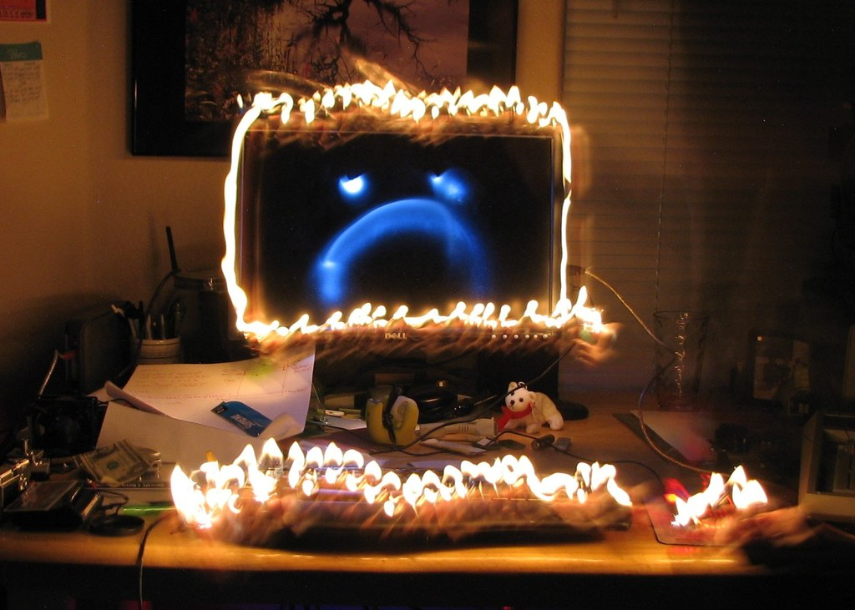
WHAT IS A COMPUTER OVERHEATING
WHEN A COMPUTER STAYS ACTIVE TOO LONG AND HEATS UP DUE TO REASONS
IT IS EASY TO SOLVE THIS PROBLEM
This Photo by Unknown Author is licensed under CC BY-SA

Slide 3
HOW TO prevent A COMPUTER OVERHEATING
First of all always make sure to never leave your computer overnight
Shut down your computer every few hours or when you feel the back of your computer warm you should wait 20-30 minuites
NEVER keep your computer in a very hot environment for long periods as this will fry the insides of your computer, think of it if as when you stay outside for a very long time
Buy a compressed air can to clean out all dust dirt and other things in their that block your computers fan
This Photo by Unknown Author is licensed under CC BY-SA-NC

Slide 4
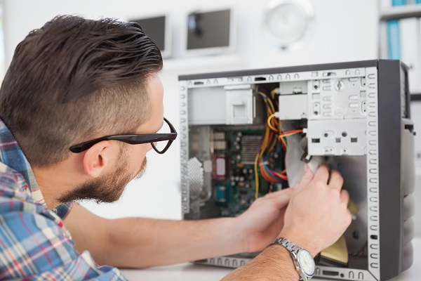
How to fix a computer when it overheats
As soon as your computer fails take it to a repair shop unless if you’re a professional you try to open it up and replace destroyed parts (TRY AT YOUR OWN RISK)
don’t drown your device in water this will not solve your problem it will only make it worse
Unplug your computer from all cables and electricity and leave it for a while this might work
This Photo by Unknown Author is licensed under CC BY-SA-NC

Slide 5
Why do computer overheat
Most of the times its usage for long times
It could be that your computer fan is filled with dirt
Running heavy applications at high framerates for hours at a time
A virus could have infected your computer(unlikely) but it is still possible when visiting sites that don’t have https and the begging and a open padlock at the top left
This Photo by Unknown Author is licensed under CC BY-SA
This Photo by Unknown Author is licensed under CC BY

Slide 6
This Photo by Unknown Author is licensed under CC BY

