Slide 1

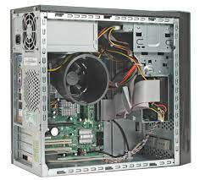

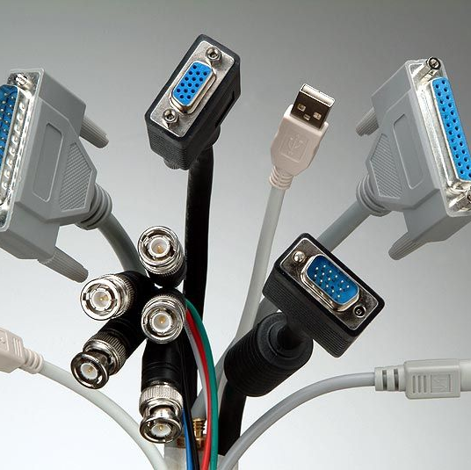
Solving computer problems safely
If in doubt , stop and ask for help
Do not open the case of your computer or any different device
Don’t lift heavy equipment on your own
Make sure all the cables are removed before trying to remove a device

