Slide 1
Please click create an account to make a new account
Create an account

Slide 2
Click here to continue
First name
Last name
Username *
Email
Password
Confirm password
Date of birth
male/female
Phone number
1
1

Slide 3
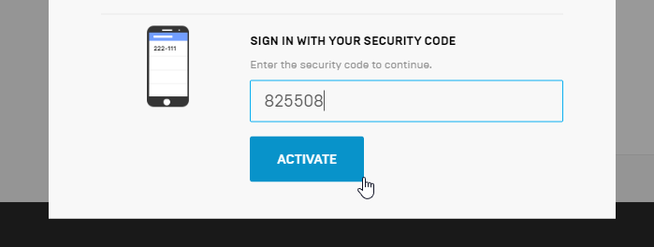
1
1
1
1

Slide 4
1
1

