Slide 1
Sneaker Shop
All types of shoes and sneakers

Slide 2
Customer Registration Form
First Name*:
Last Name*:
Username*:
Password:
Confirm password:
Phone number:
Date of Birth*:
Email*:
Address:
City:
Region:
Preferred Location:
I am interested:
Max Budget $:
Comments:

Slide 3
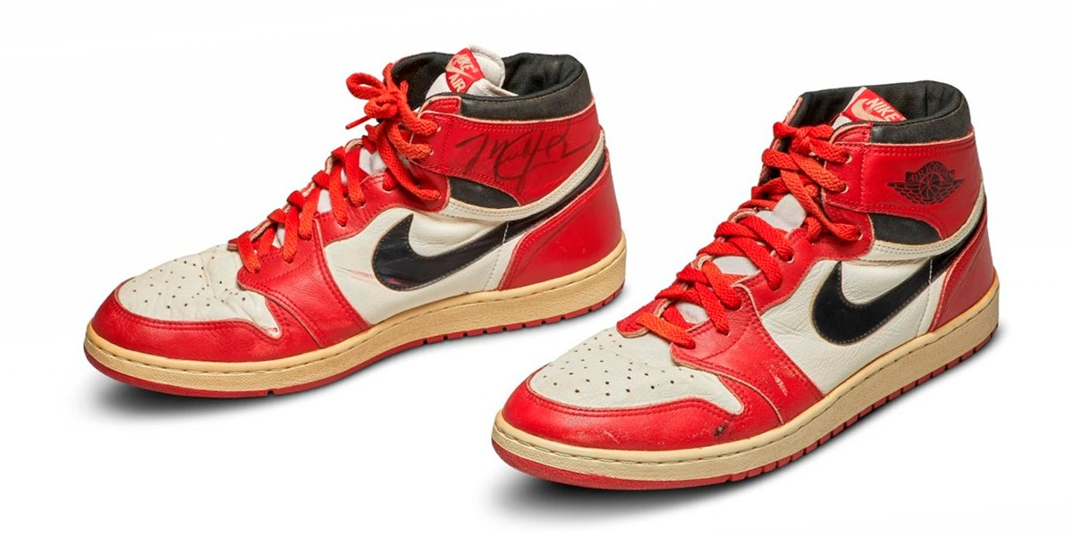
Products
Jordan 4 s
Jordan 1 s

Slide 4
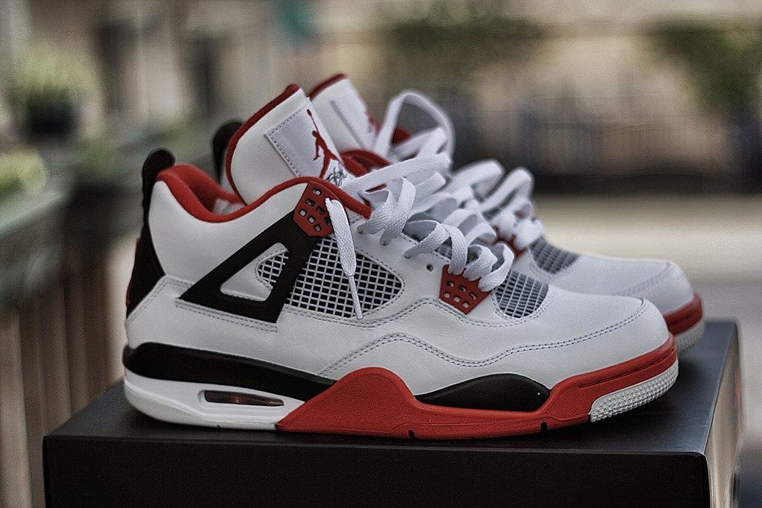
Products
Original Jordan Force 4 s
Light blue Jordan 1 s

Slide 5
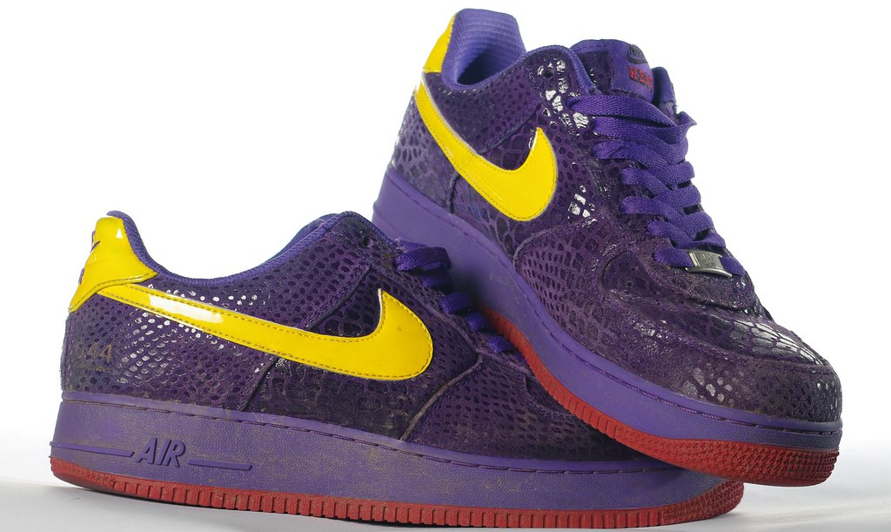
Products
Off whites
Purple air forces

